Slide 1

Green Business, Ecolabelling

Slide 2
Green Business ref
Sustainable business, or green business, is an enterprise that has minimal negative impact on the global or local environment, community, society, or economy
A sustainable business is any organization that participates in environmentally friendly or green activities to ensure that all processes, products, and manufacturing activities adequately address current environmental concerns while maintaining a profit.

Slide 3
It incorporates principles of sustainability into each of its business decisions.
It supplies environmentally friendly products or services that replaces demand for nongreen products and/or services.
It has made an enduring commitment to environmental principles in its business operations

Slide 4
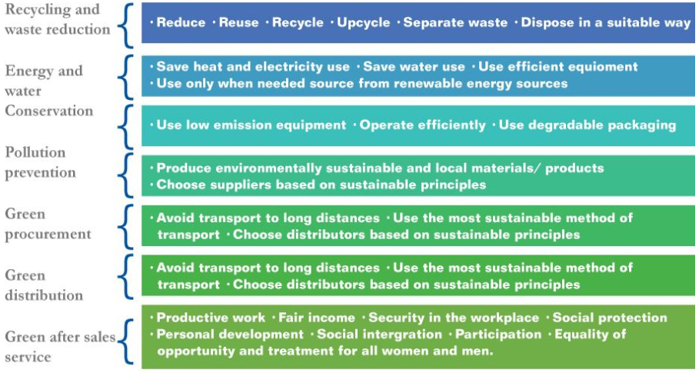
Green business pillars ref
Source: http://www.ilo.org/wcmsp5/groups/public/---asia/---ro-bangkok/documents/publication/wcms_424963.pdf

Slide 5
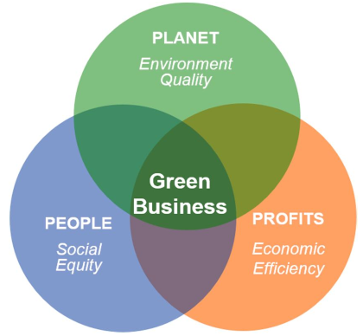
Eliminate or decrease the environmental harm caused by the production and consumption of their goods
Profit of the organizations share with community
Economical benefits to the workers, community
Source: http://www.ilo.org/wcmsp5/groups/public/---asia/---ro-bangkok/documents/publication/wcms_424963.pdf

Slide 6
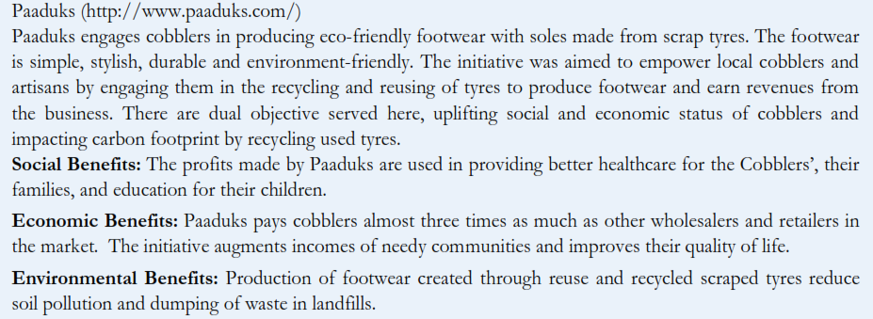
Source: http://www.ilo.org/wcmsp5/groups/public/---asia/---ro-bangkok/documents/publication/wcms_424963.pdf

Slide 7
Six essential characteristics of Green Business ref
1. Triple top-line value production - financial benefits for the company, natural world betterment, and social advantages for employees and members of the local community
2. Nature-based knowledge and technology - biomimicry-based principal involves the conscious emulation of natural-world genius in terms of growing our food, harnessing our energy, constructing things, conducting business healing ourselves, processing information and designing our communities

Slide 8
3. Products of service to products of consumption - Products of service are durable goods routinely leased by the customer that are made of technical materials and are returned to the manufacturer and re-processed into a new generation of products when they are worn out.
4. Solar, wind, geothermal and ocean energy - employing only sustainable energy technology—solar, wind, ocean and geothermal—that can meet our energy needs indefinitely without negative effects for life on earth.

Slide 9
5. Local-based organizations and economies - This ingredient includes durable, beautiful and healthy communities with locally owned and operated businesses and locally managed non-profit organizations, along with regional corporations and shareholders working together in a dense web of partnerships and collaborations
6. Continuous improvement process - The continuous process of monitoring, analyzing, redesigning and implementing is used to intensify TTL value production as conditions change and new opportunities emerge

Slide 10
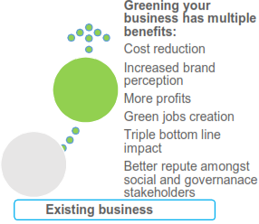
Extra Resources
Green Business Model Innovation
Sustainable Business Case Studies
Little Green Bags: True Business Sustainability
Business Case for Sustainability
Source: http://www.ilo.org/wcmsp5/groups/public/---asia/---ro-bangkok/documents/publication/wcms_424963.pdf

Slide 11
Ecolabelling
The concept of Ecolabelling is to encourage environmentally friendly commodities in the market.
Ecolabelling was first introduced in Germany in 1978.
It enforce the companies to develop products and processes having lesser environmental impact.
In 1991, GoI launched its first eco-label, known as ‘Eco-mark’ through Central Pollution Control Board (CPCB),

Slide 12
GoI that follows a cradle-to-grave approach (from raw material extraction, to manufacturing, and to disposal).
It advocates pro-active and promotional roles of the consumers, the industry, and the government at one platform to address environmental protection issues and to implement environmental protection strategy

Slide 13

Eco-label acts as a qualifying criterion for companies for improved environmental management to ensure long term stewardship and availability of natural resources for a nation’s sustainable growth.
Source: https://www.google.co.in/url?sa=i&rct=j&q=&esrc=s&source=images&cd=&cad=rja&uact=8&ved=0ahUKEwiV4sWIqMfWAhXFJZQKHdafDBUQjRwIBw&url=https%3A%2F%2Fen.wikipedia.org%2Fwiki%2FEcomark&psig=AFQjCNFKTYLJJpS9m2a1bOu0tH2FkUVJRg&ust=1506668527290677

Slide 14
Criteria for Ecomark
The following primary environmental criteria for products are prescribed:
that they cause substantially less pollution than other comparable products in production, usage and disposal;
that they are recycled and/or recyclable where comparable products are not;
that their price is not extraordinarily higher than comparable products; and

Slide 15
that they make a significant contribution to saving non-renewable resources or minimizing use of renewable resources compared with other comparable products;
that they contribute to a reduction of adverse environmental health consequences;
that they comply with laws, standard and regulations pertaining to the environment.

Slide 16
Extra Resources
Introduction to Ecolabelling
https://www.globalecolabelling.net/what-is-eco-labelling/
http://www.ecospecifier.com.au/knowledge-green/technical-guides/technical-guide-9-introduction-to-ecolabels-and-environmental-product-declarations.aspx

